Slide 1


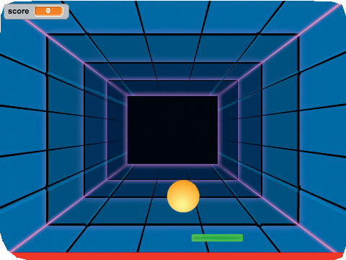
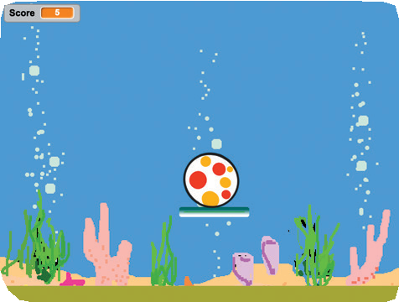
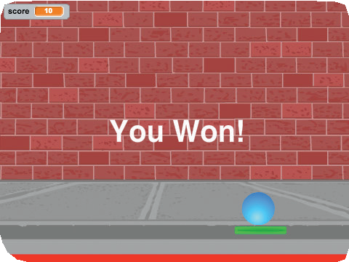
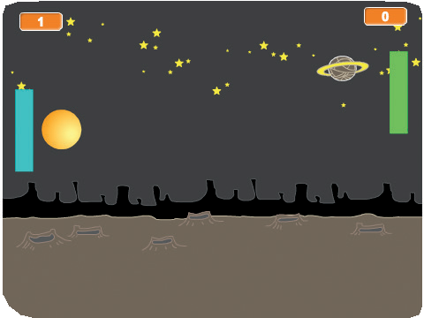

Pong Game Cards
Pong Game
Make a bouncing ball game with sounds, points, and other effects.
scratch.mit.edu/pong

Slide 2
Pong Game Cards
Pong Game
Use these cards in this order:
Bounce Around Move the Paddle
Bounce Off the Paddle Game Over
Score Points Win the Game
1
2
3
4
5
6
scratch.mit.edu/pong

Slide 3




Bounce Around
Create Pong!
Step 1
Make a ball move around the Stage.
Pong Game
1

Slide 4





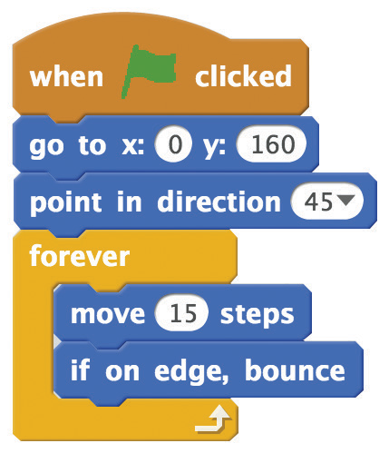



Bounce Around
scratch.mit.edu/pong
GET READY
Choose a ball.
Choose a backdrop.
ADD THIS CODE
Set the initial position. Type the initial direction.
Type a bigger number to move faster.
TRY IT
Click the green flag to start.
TIP
sets the direction of the ball.
0
45
90
-90
180

Slide 5



Move the Paddle
Control a paddle by moving your mouse pointer.
Pong Game
2

Slide 6


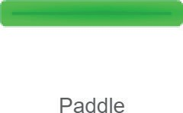
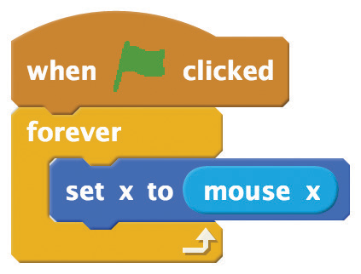


Move the Paddle
scratch.mit.edu/pong
GET READY
Choose a paddle.
Drag the paddle to the bottom of the Stage.
ADD THIS CODE
Insert the mouse x block in the set x to block.
TRY IT
Click the green
flag to start.
Move your mouse pointer to move the paddle.
TIP
changes as you move the mouse pointer across the Stage.

Slide 7



Bounce Off the Paddle
Make the ball bounce off the paddle.
Pong Game
3

Slide 8

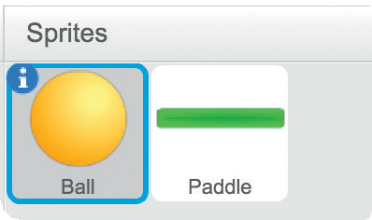
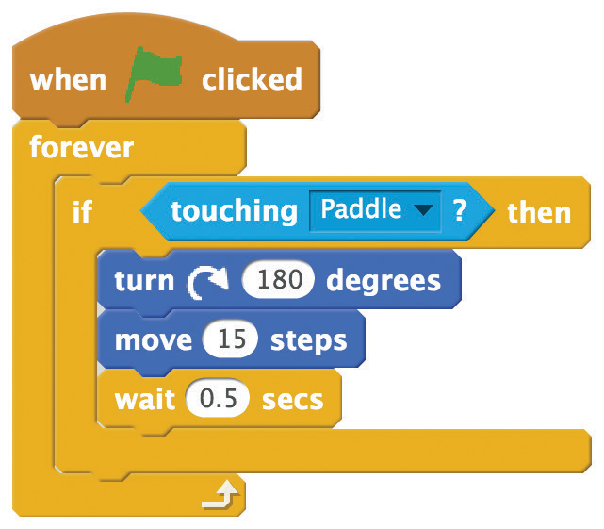


Bounce Off the Paddle
scratch.mit.edu/pong
GET READY
Click to select
the Ball sprite.
ADD THIS CODE
Choose the Paddle
sprite from the menu.
TRY IT
Click the green flag to start.
TIP
Insert a pick random block to make the ball bounce in different directions.
Use numbers around 180.

Slide 9
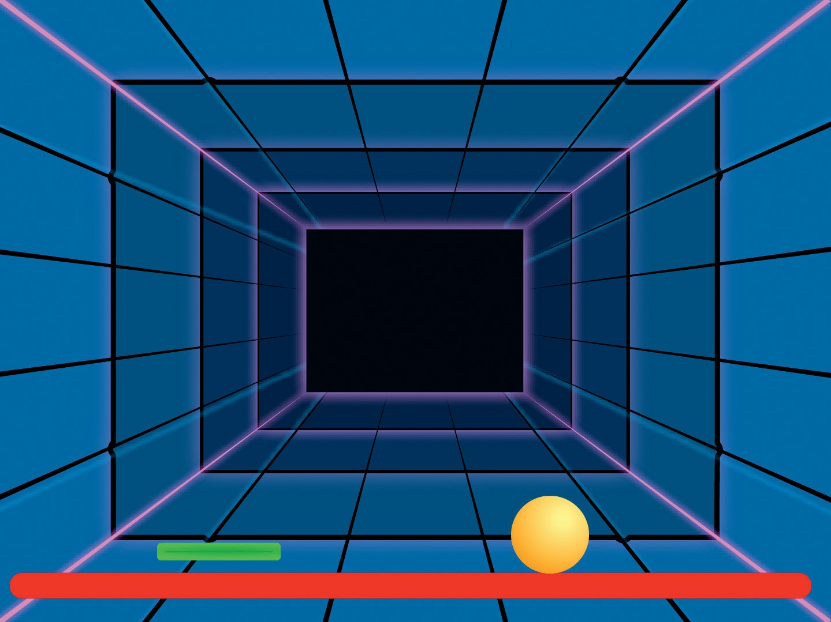
Game Over
Stop the game if the ball hits the red line.
Pong Game
4

Slide 10
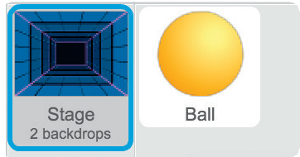




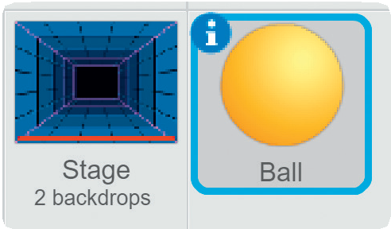
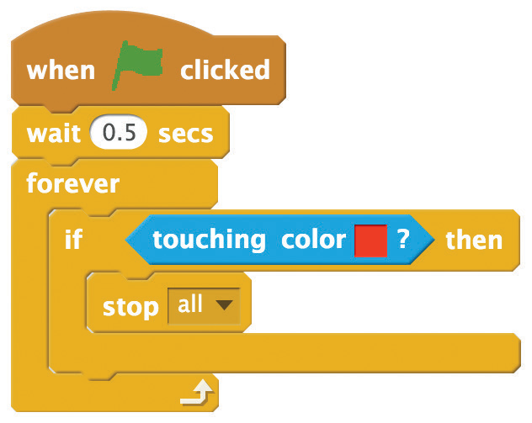

Game Over
scratch.mit.edu/pong
GET READY
Click to select the Stage.
Then, click the
tab.
Draw a line at the bottom. (To make a straight line, hold down the Shift key while drawing.)
Choose the Line tool and pick the color red.
ADD THIS CODE
Click the tab.
Click to select Ball.
To pick the color, click this square and then click the red line on the Stage.
TRY IT
Click the green flag to start.

Slide 11
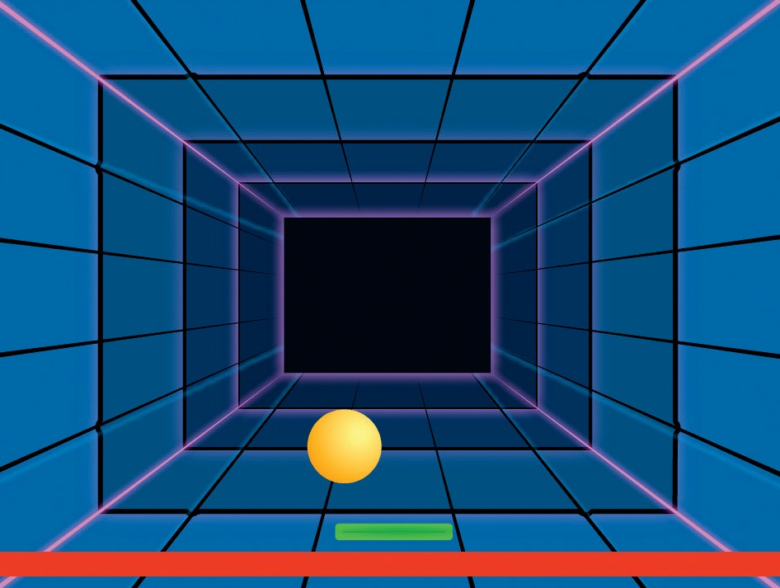



Score Points
Add a point each time you hit the ball with the paddle.
Pong Game
5

Slide 12

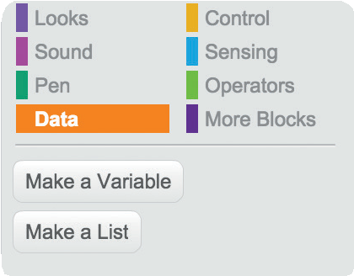
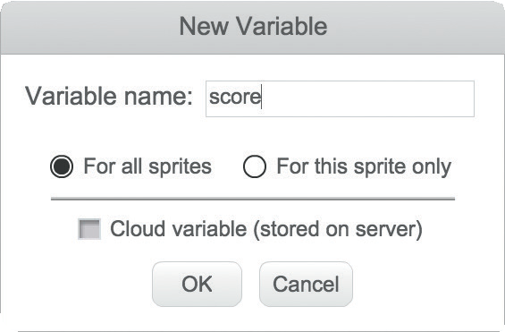
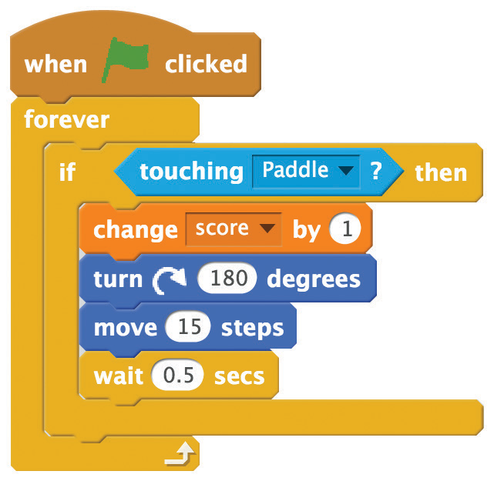

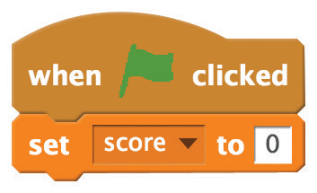
Score Points
scratch.mit.edu/pong
GET READY
Choose Data.
Click the Make a Variable button.
Name this variable score
and then click OK.
ADD THIS CODE
Add this block.
TIP
Use a set score to 0 block to reset the score when you click the green flag.

Slide 13


Win the Game
When you score enough points, display a winning message!
Pong Game
6

Slide 14


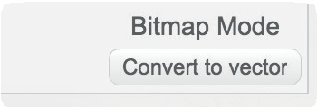
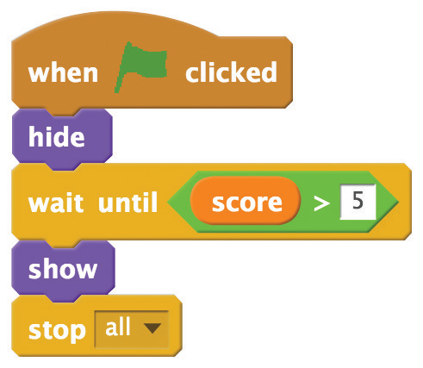

Win the Game
scratch.mit.edu/pong
GET READY
Click the paintbrush to draw a new sprite.
Use the Text tool to write a message, like “You won!”
Click the Convert to vector button.
You can change the font color, size, and style.
ADD THIS CODE
Click the tab.
Insert the score block.
TRY IT
Click the green
flag to start.
Play until you score enough points to win!

